Slide 2
My pets Lesson 1 - Period 2
16

Slide 3
1
2
3
Warm-up and review
4
5
Fun corner and wrap-up
Listen and tick.
Look, complete and read.
Let’s sing.

Slide 4
1
Warm-up and review

Slide 5
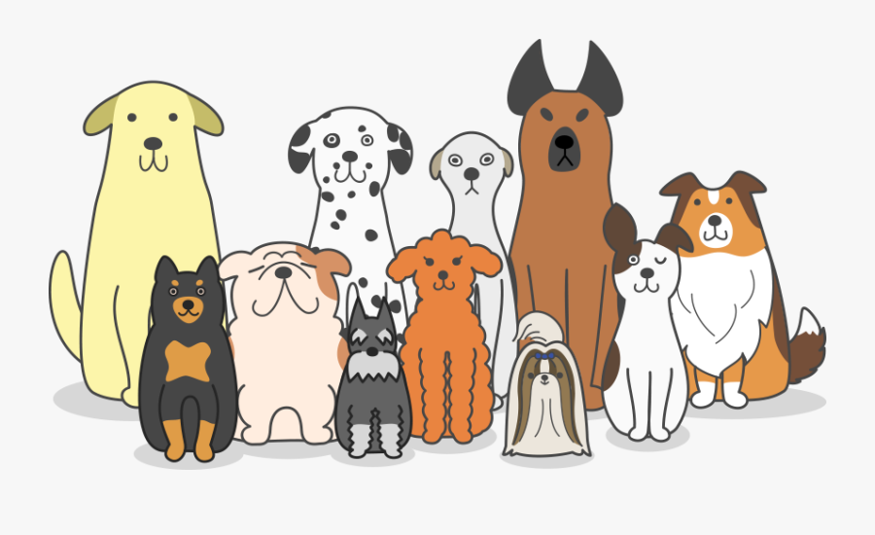
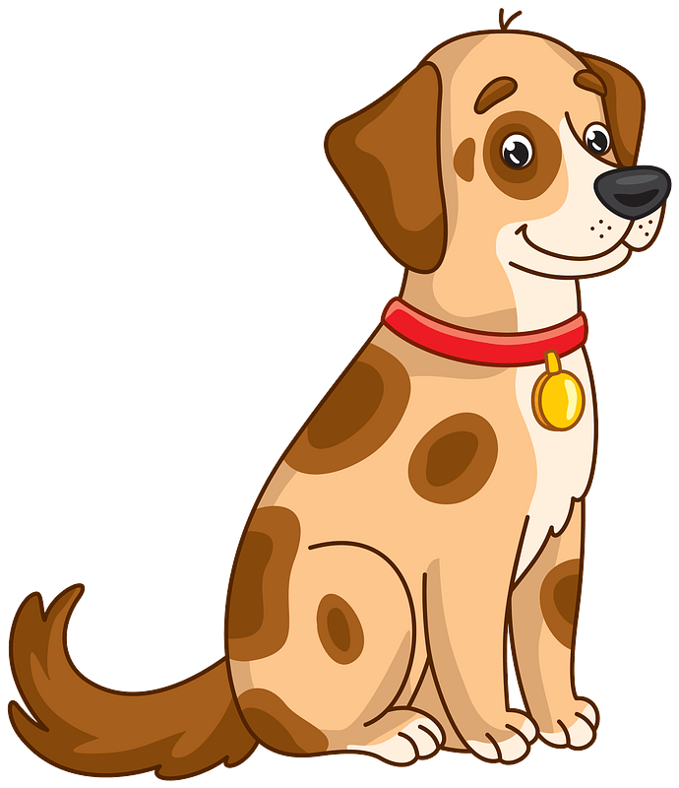
a dog
dogs

Slide 6
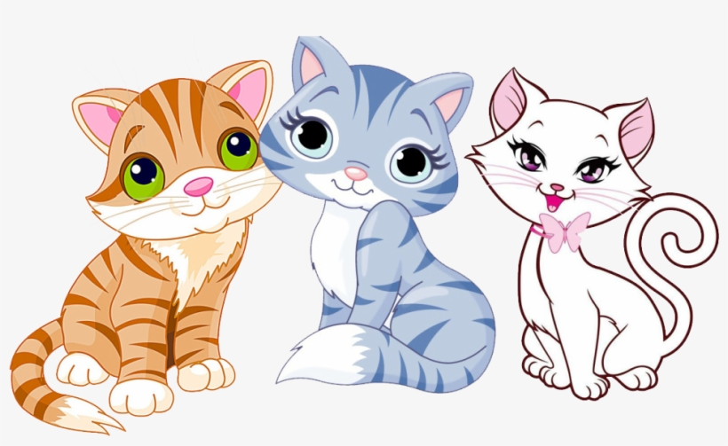
a cat
cats

Slide 7
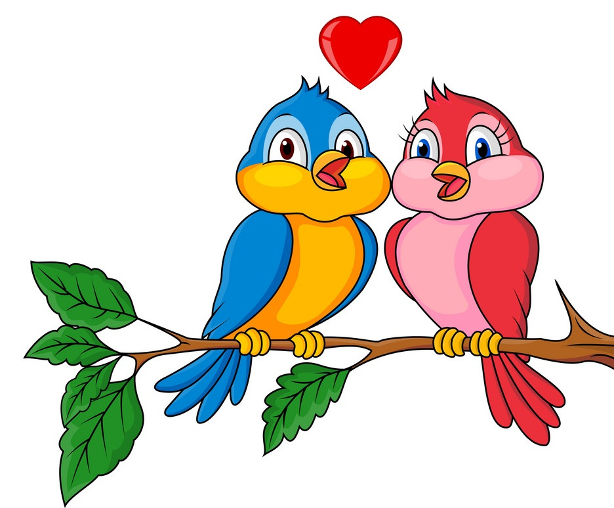
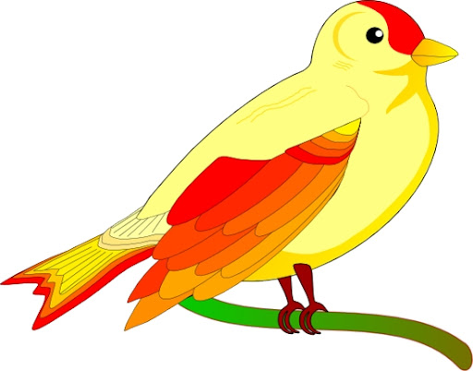
a bird
birds

Slide 8
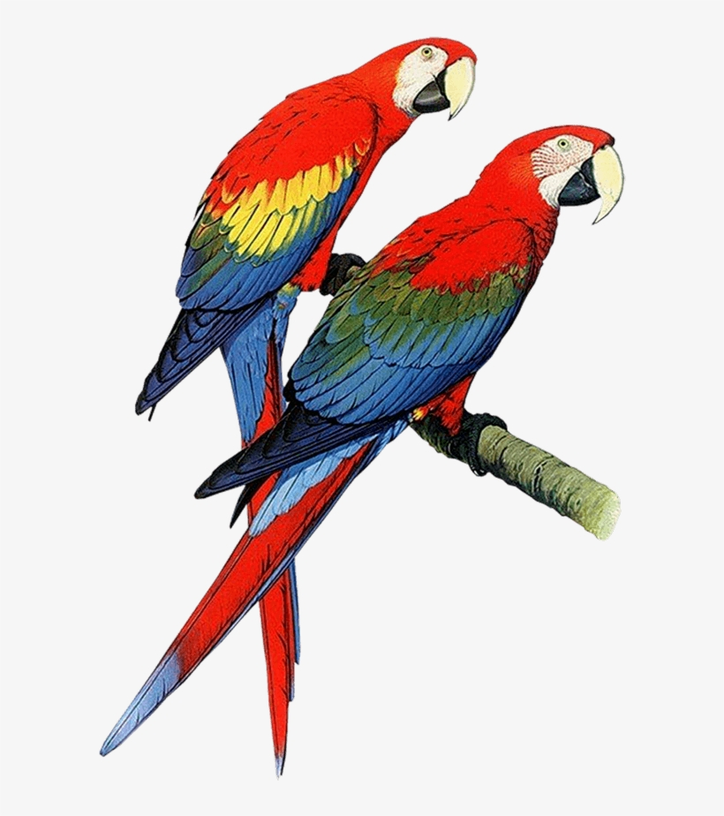
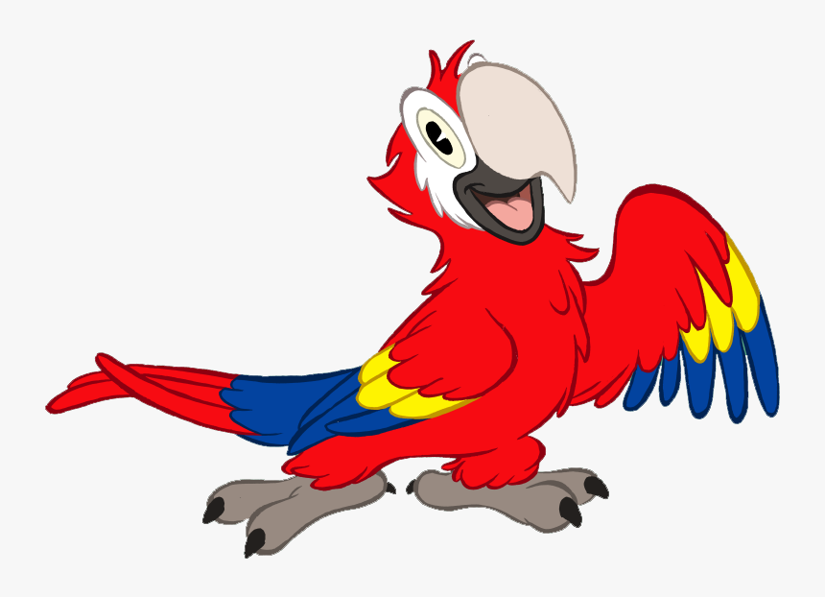
a parrot
parrots

Slide 9
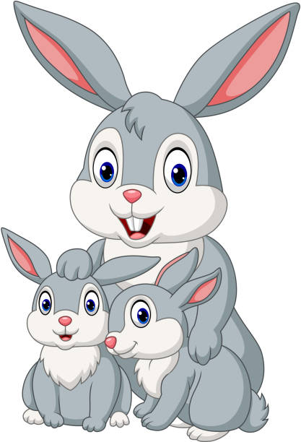
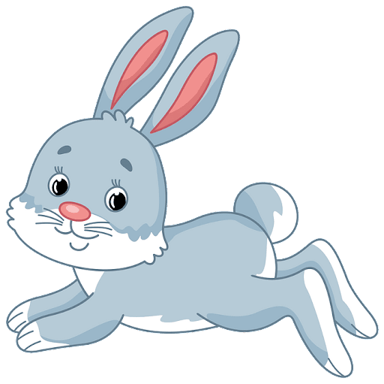
a rabbit
rabbits

Slide 10
Look and guess.

Slide 11
1
2
3
4
5
6
7
8
9
a cat

Slide 12
1
2
3
4
5
6
7
8
9
a dog

Slide 13
1
2
3
4
5
6
7
8
9
parrots

Slide 14
1
2
3
4
5
6
7
8
9
cats

Slide 15
1
2
3
4
5
6
7
8
9
a bird

Slide 16
1
2
3
4
5
6
7
8
9
rabbits

Slide 17
2
Listen and tick.

Slide 19
3
Look, complete and read.

Slide 20
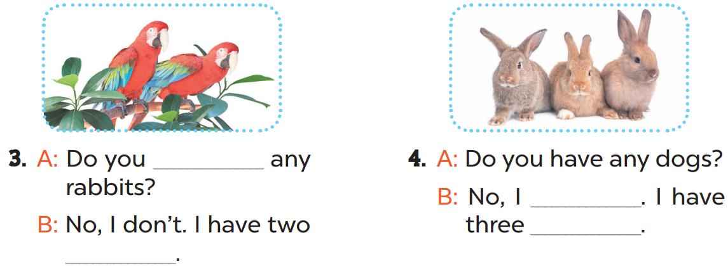
cats
dogs
have
don’t
rabbits
parrots

Slide 21
4
Let’s sing.

Slide 23
5
Fun corner and wrap-up

Slide 24
TEAM 1
TEAM 2
TEAM 3

Slide 25
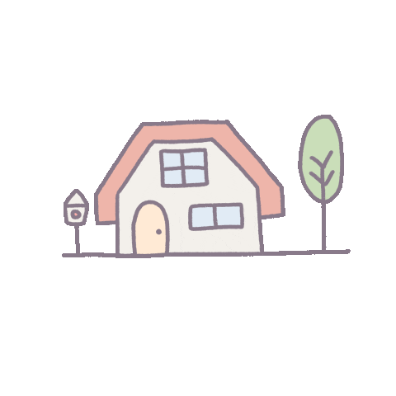
= 1 point
= - 2 points
= 5 points

Slide 26
Do you have any dogs?
Yes, I do. I have one dog.

Slide 27
Do you have any fish?
Yes, I have. I have 2 rabbits.

Slide 28
Do you have any cats?
Yes, I have one cat.

Slide 29
Do you have any rabbits?
No, I don’t. I have three cats.

Slide 30
Do you have any dogs?
No, I don’t. I have one rabbit.

Slide 31
Do you have any parrots?
Yes, I do.

Slide 32
Do you have any birds?
Yes, I do. I have 2 parrots.

Slide 33
Do you have any dogs?
Yes, I do.

Slide 34
Do you have any cats?
No, I don’t. I have one bird.

Slide 35
Website: sachmem.vn
Fanpage: www.facebook.com/sachmem.vn

