Slide 1
If you’re happy

Slide 2
WARM UP

Slide 3
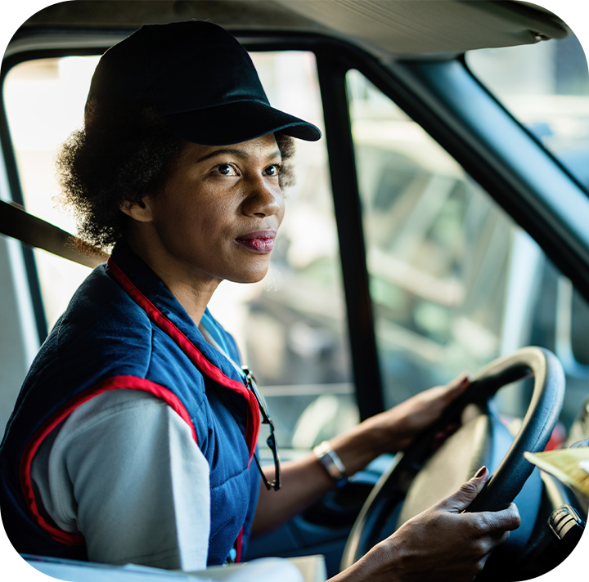
4. Listen and tick.
1
a
b
2
a
b
Notes:
Facebook : Bùi Liễu
Mobile phone: 0968142780

Slide 4
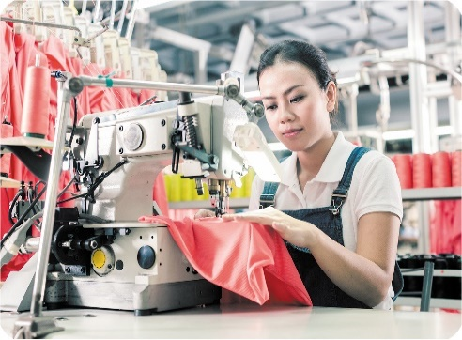
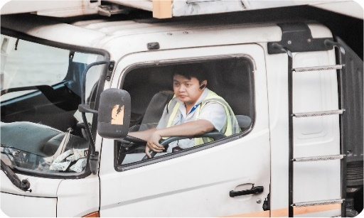
5. Look, complete and read.
1. She’s _______.
2. He’s ________.
a doctor
a teacher
3. A: What’s her job?
B: He’s ________.
B: She’s ________.
4. A: What’s his job?
a worker
a driver
Notes:
Facebook : Bùi Liễu
Mobile phone: 0968142780

Slide 5
6. Let’s sing.
My mother and my father
Who’s this?
Who’s this?
It’s my mother.
It’s my mother.
What’s her job?
She’s a worker.
She’s a worker.
Who’s that?
Who’s that?
It’s my father.
It’s my father.
What’s his job?
He’s a driver.
He’s a driver.
Notes:
Facebook : Bùi Liễu
Mobile phone: 0968142780

Slide 6
6. Let’s sing.
My mother and my father
Who’s this?
Who’s this?
It’s my mother.
It’s my mother.
What’s her job?
She’s a worker.
She’s a worker.
Who’s that?
Who’s that?
It’s my father.
It’s my father.
What’s his job?
He’s a driver.
He’s a driver.
Notes:
Facebook : Bùi Liễu
Mobile phone: 0968142780

Slide 7
6. Let’s sing.
My mother and my father
Who’s this?
Who’s this?
It’s my mother.
It’s my mother.
What’s her job?
She’s a worker.
She’s a worker.
Who’s that?
Who’s that?
It’s my father.
It’s my father.
What’s his job?
He’s a driver.
He’s a driver.
Notes:
Facebook : Bùi Liễu
Mobile phone: 0968142780

Slide 8
Homework
Do your homework in.
Read again the dialogue in part 5.

Slide 9
Facebook : Bùi Liễu
0968142780
Thank you!

