Slide 1
I have a pet!

Slide 2
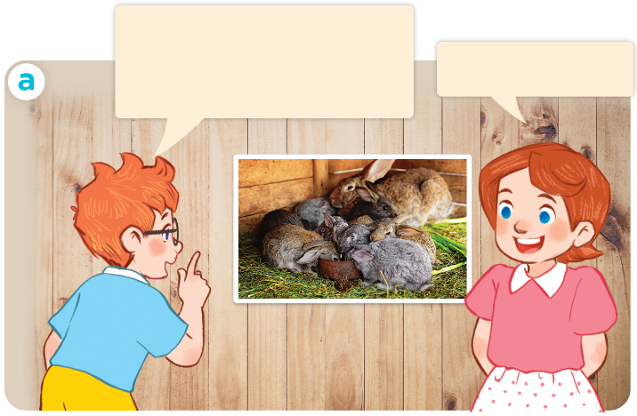
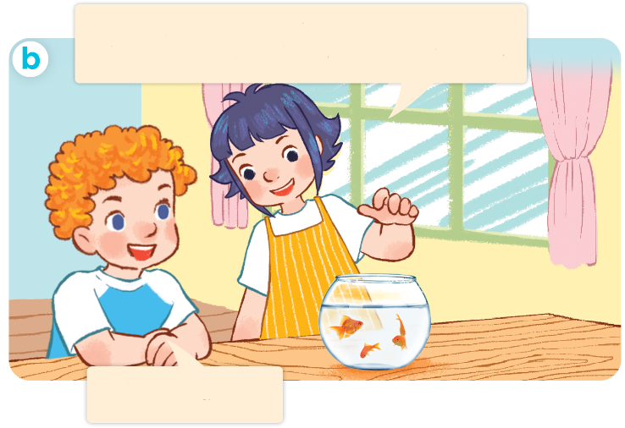
I have two rabbits. How many rabbits do you have?
1. Look, listen and repeat.
I have two rabbits.
How many rabbits do you have?
These are my goldfish. How many goldfish do you have?
I have many.
I have some.

Slide 3
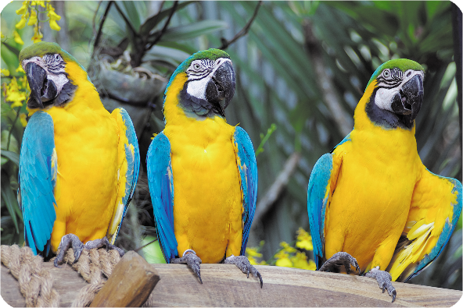
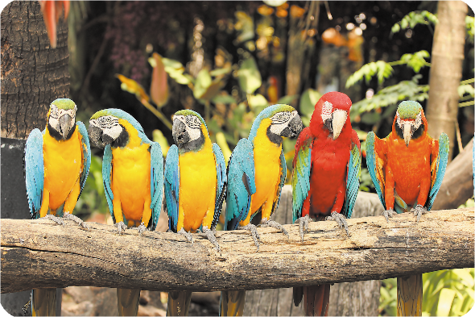
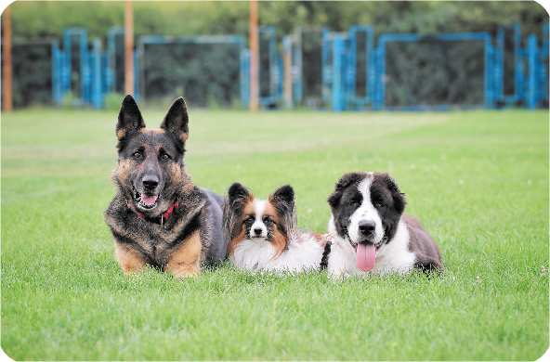
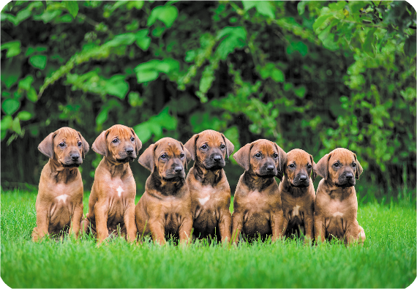
2. Listen, point and say.
How many _____ do you have?
a
b
parrots / some
parrots / many
I have ____.
c
d
dogs / some
dogs / many

Slide 4
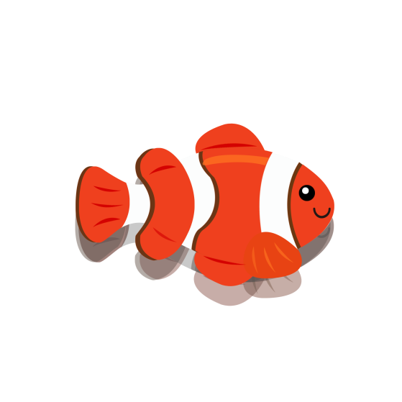

Slide 5
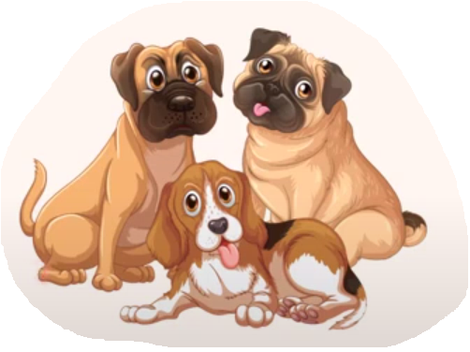

Slide 6
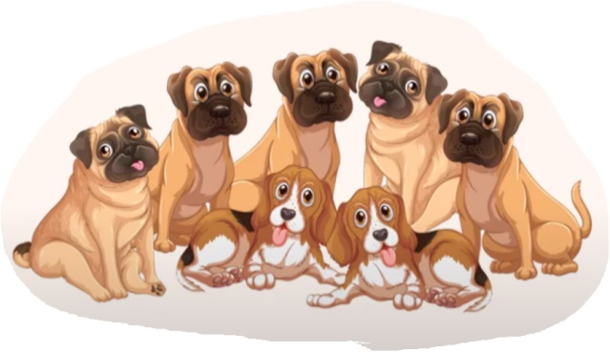

Slide 7
Facebook : Bùi Liễu
0968142780
Choose the best answer!

Slide 8
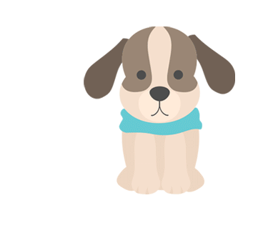
A
B
C
✔
1. dog

Slide 9
A
B
C
✔
2. goldfish

Slide 10
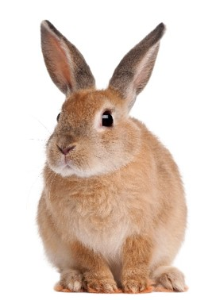
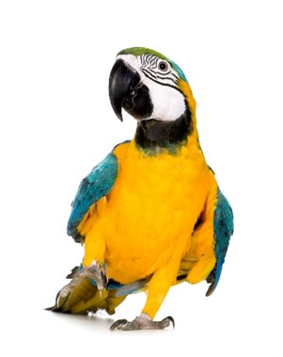
A
B
C
✔
3. parrot

Slide 11
A
B
C
✔
4. many

Slide 12
A
B
C
✔
5. some

Slide 13
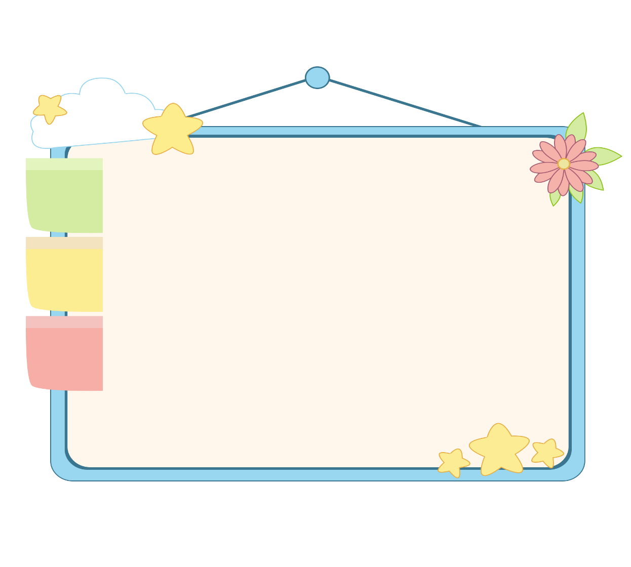
WELL DONE!

Slide 14
I have two rabbits. How many rabbits do you have?
I have two rabbits.
How many rabbits do you have?
These are my goldfish. How many goldfish do you have?
I have many.
I have some.

Slide 15
2. Listen, point and say.
How many _____ do you have?
b
parrots
a
parrots / some
parrots / many
I have ____.
some
c
d
dogs / some
dogs / many

Slide 16
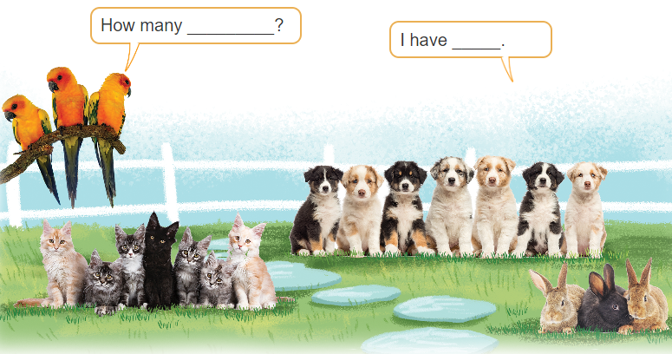
3. Let’s talk

Slide 17
Facebook : Bùi Liễu
0968142780
Thank you!

